Slide 1
The Swift Education and Public Outreach Program
Lynn Cominsky
Sonoma State University
March 2, 2005

Slide 2
Program Overview
Swift E/PO Web site (http://swift.sonoma.edu)
Launch products
Printed materials
Teacher’s activity booklets and posters
Educator training
Conference workshops
Educator Ambassadors
Informal Education
Global Telescope Network
GRB Skymap website
Program Evaluation
Future Plans

Slide 3
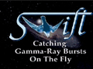
E/PO Web Site
Now integrated with Science site
Both sites use “One NASA” format
Reorganized:
Educators
Public
Image Gallery
Presentations
Related Links
Swift FAQ
To order: http://epo.sonoma.edu/orderformpublic.html
And a multi-media area too!

Slide 4
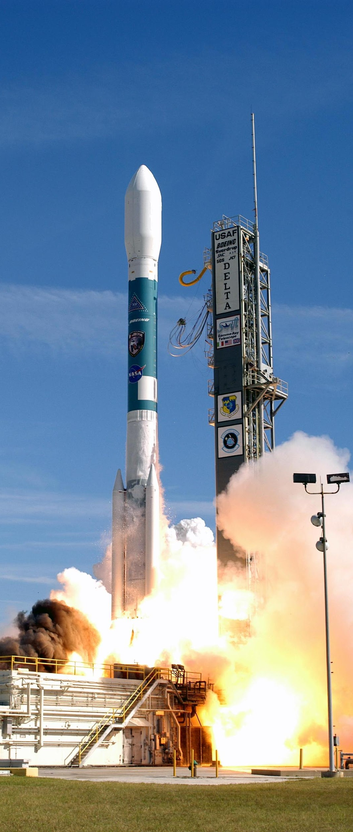
Launch Products
Model booklet
Lithograph with educational activity
Fact sheet
CD with http://swift.gsfc.nasa.gov
Stickers
Patches
Angling for GRBs poster
Teeshirts

Slide 5
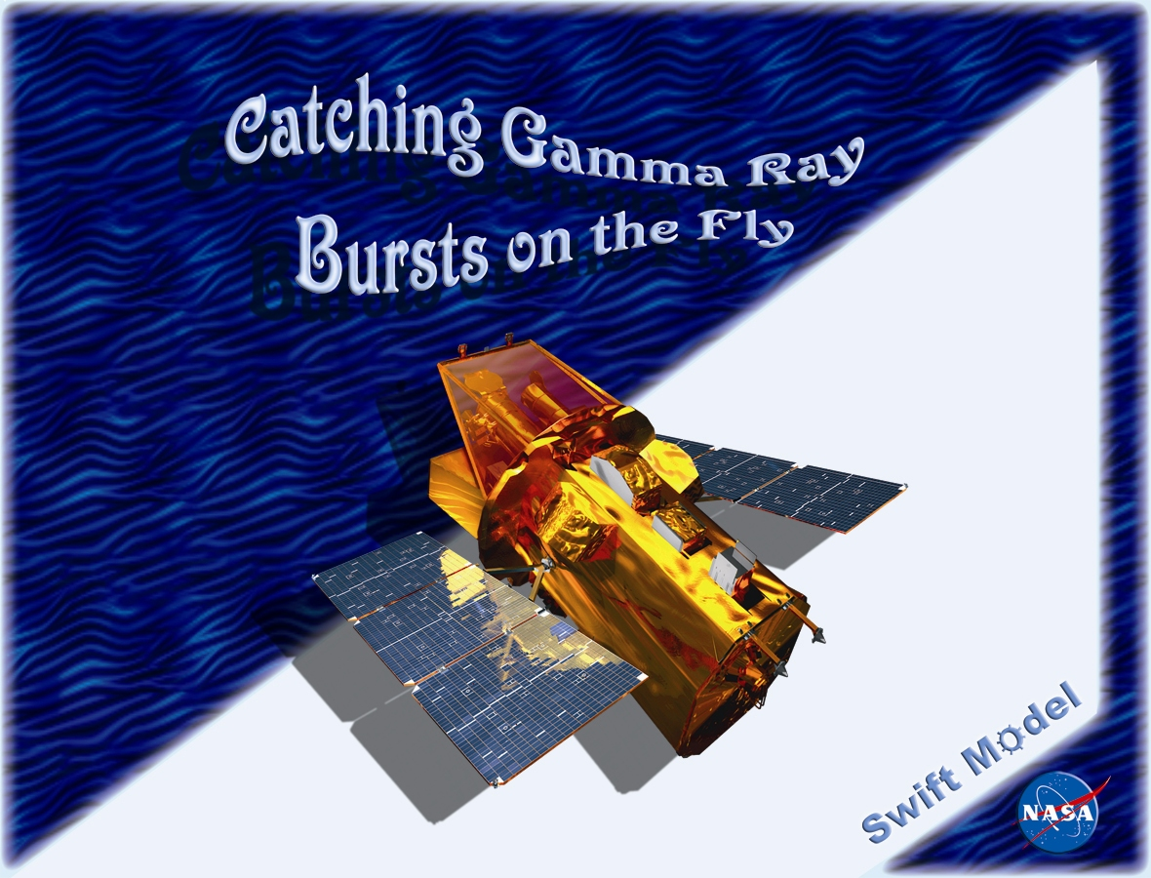
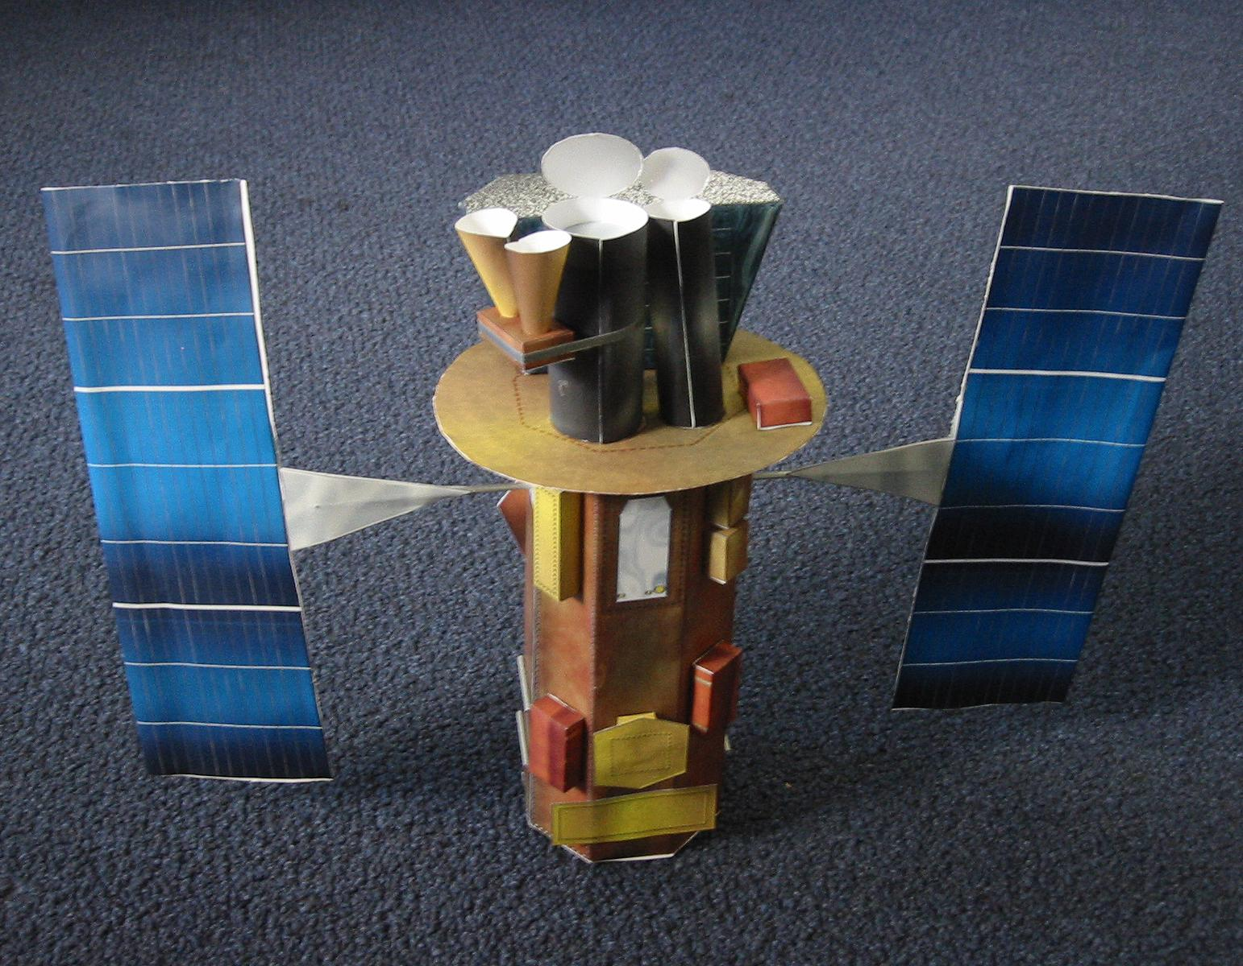
Swift model booklet
Based on Monica Sperandio’s concept (Italian)
Handed out at launch

Slide 6
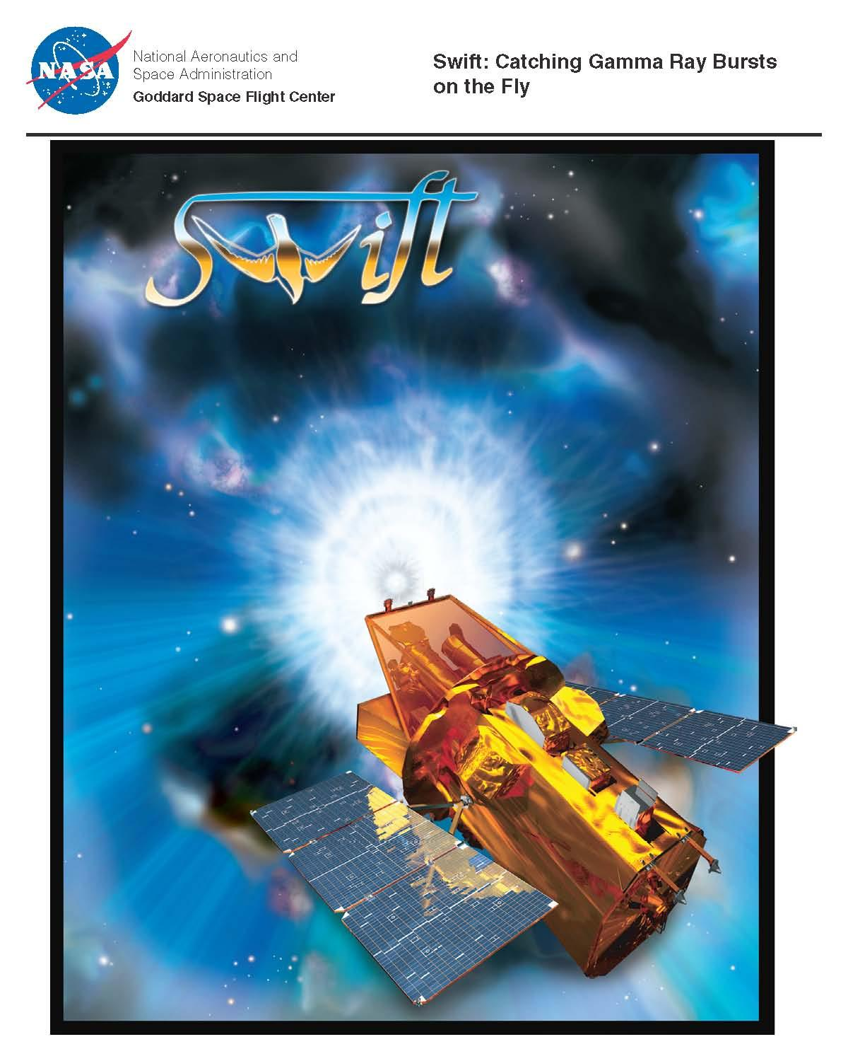
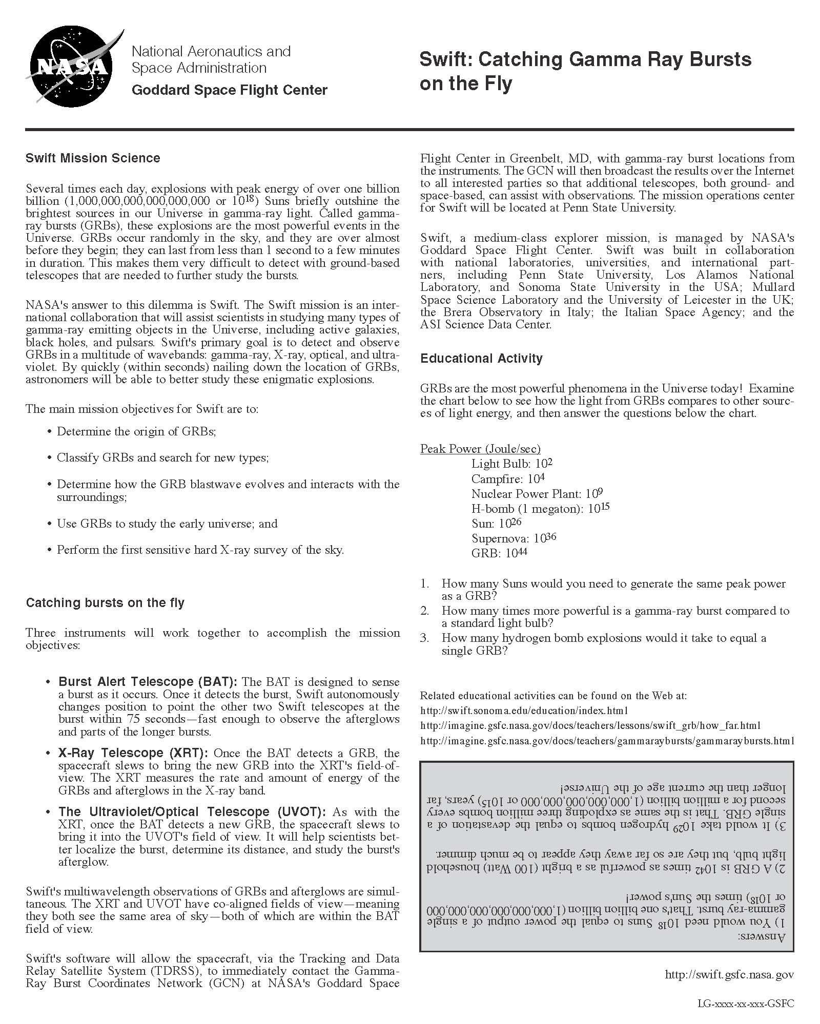
Launch Lithograph
Educational activity on the back

Slide 7
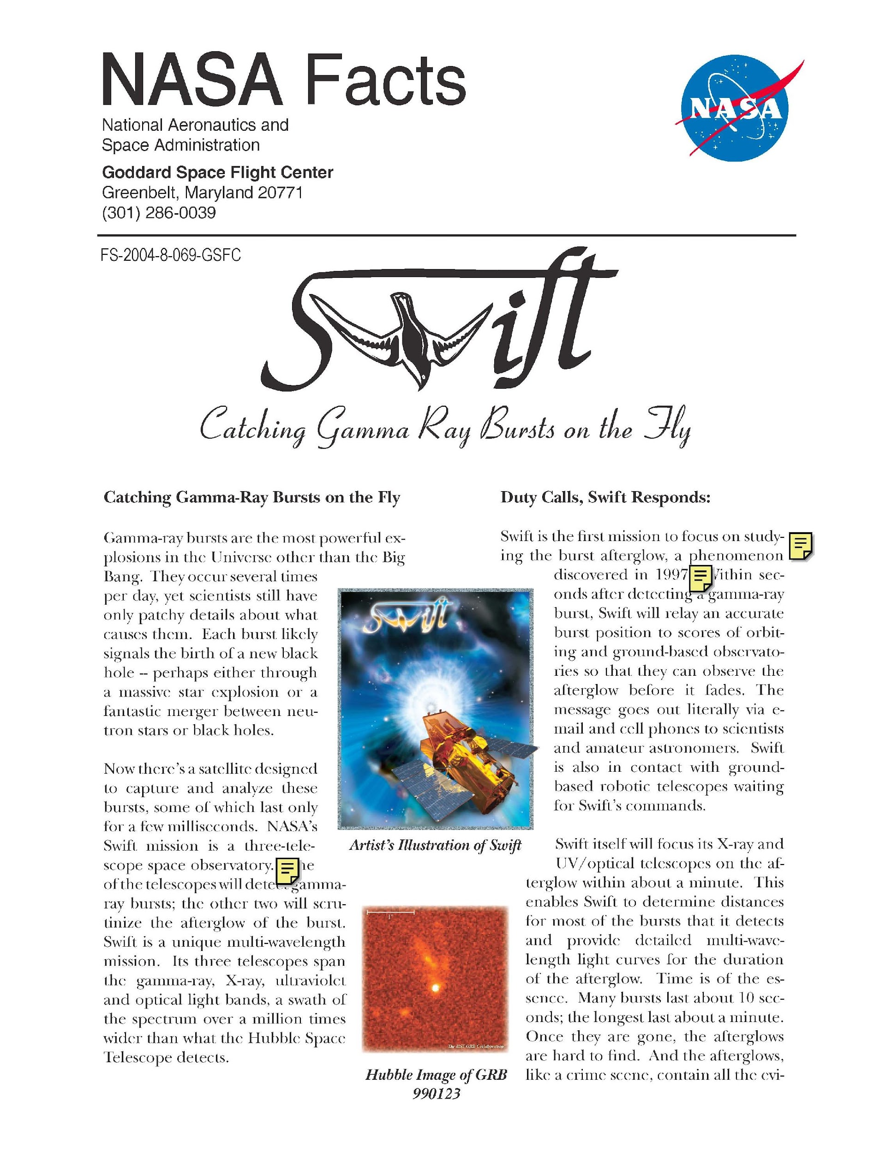
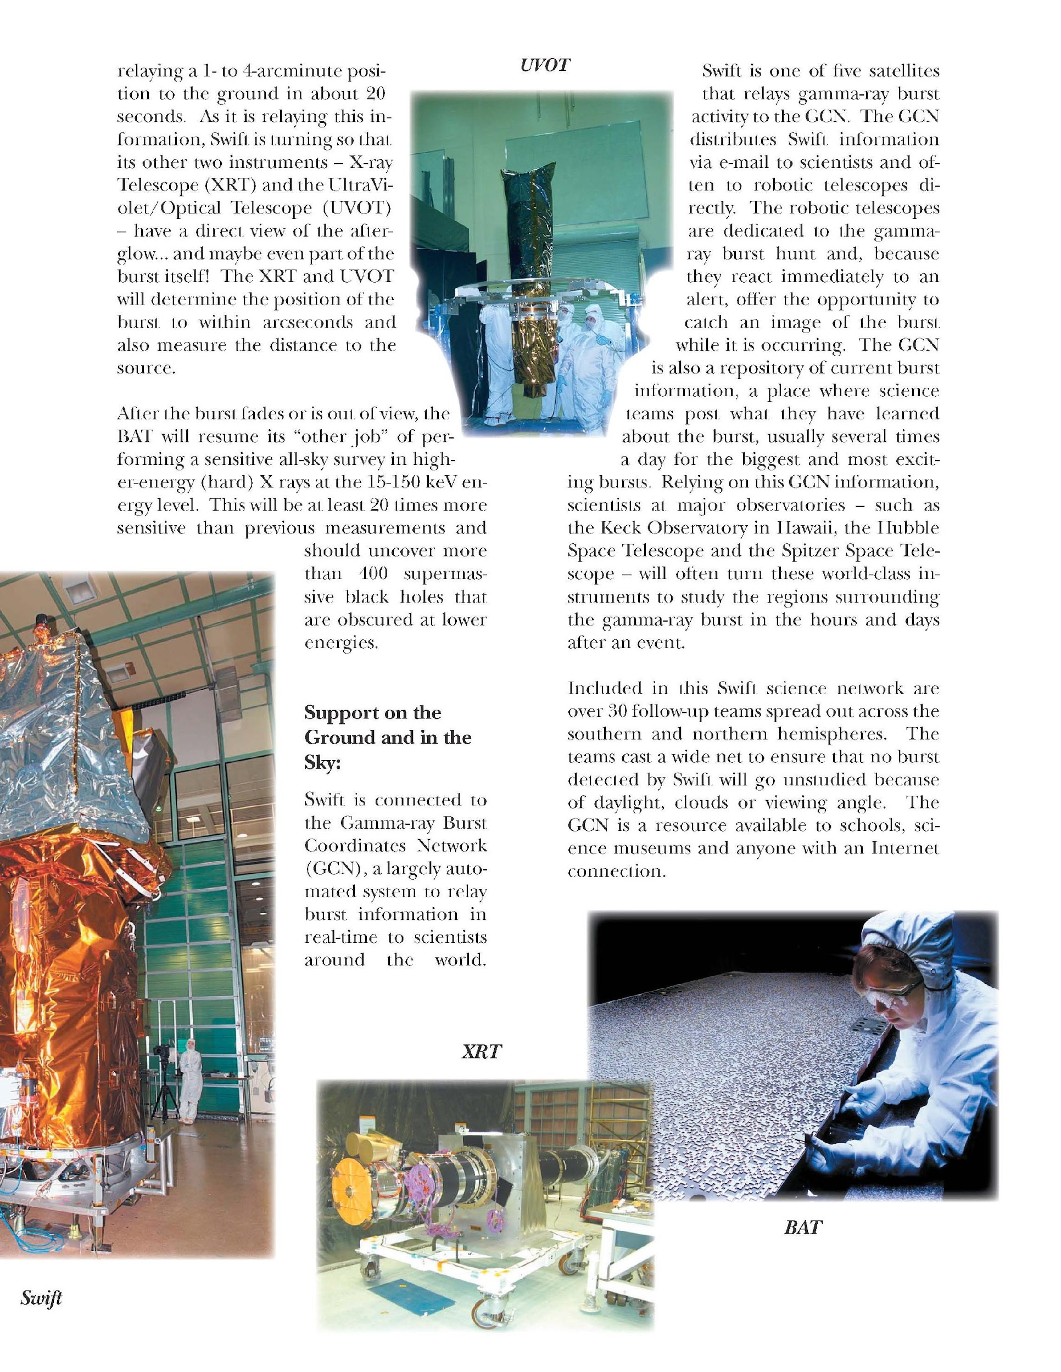
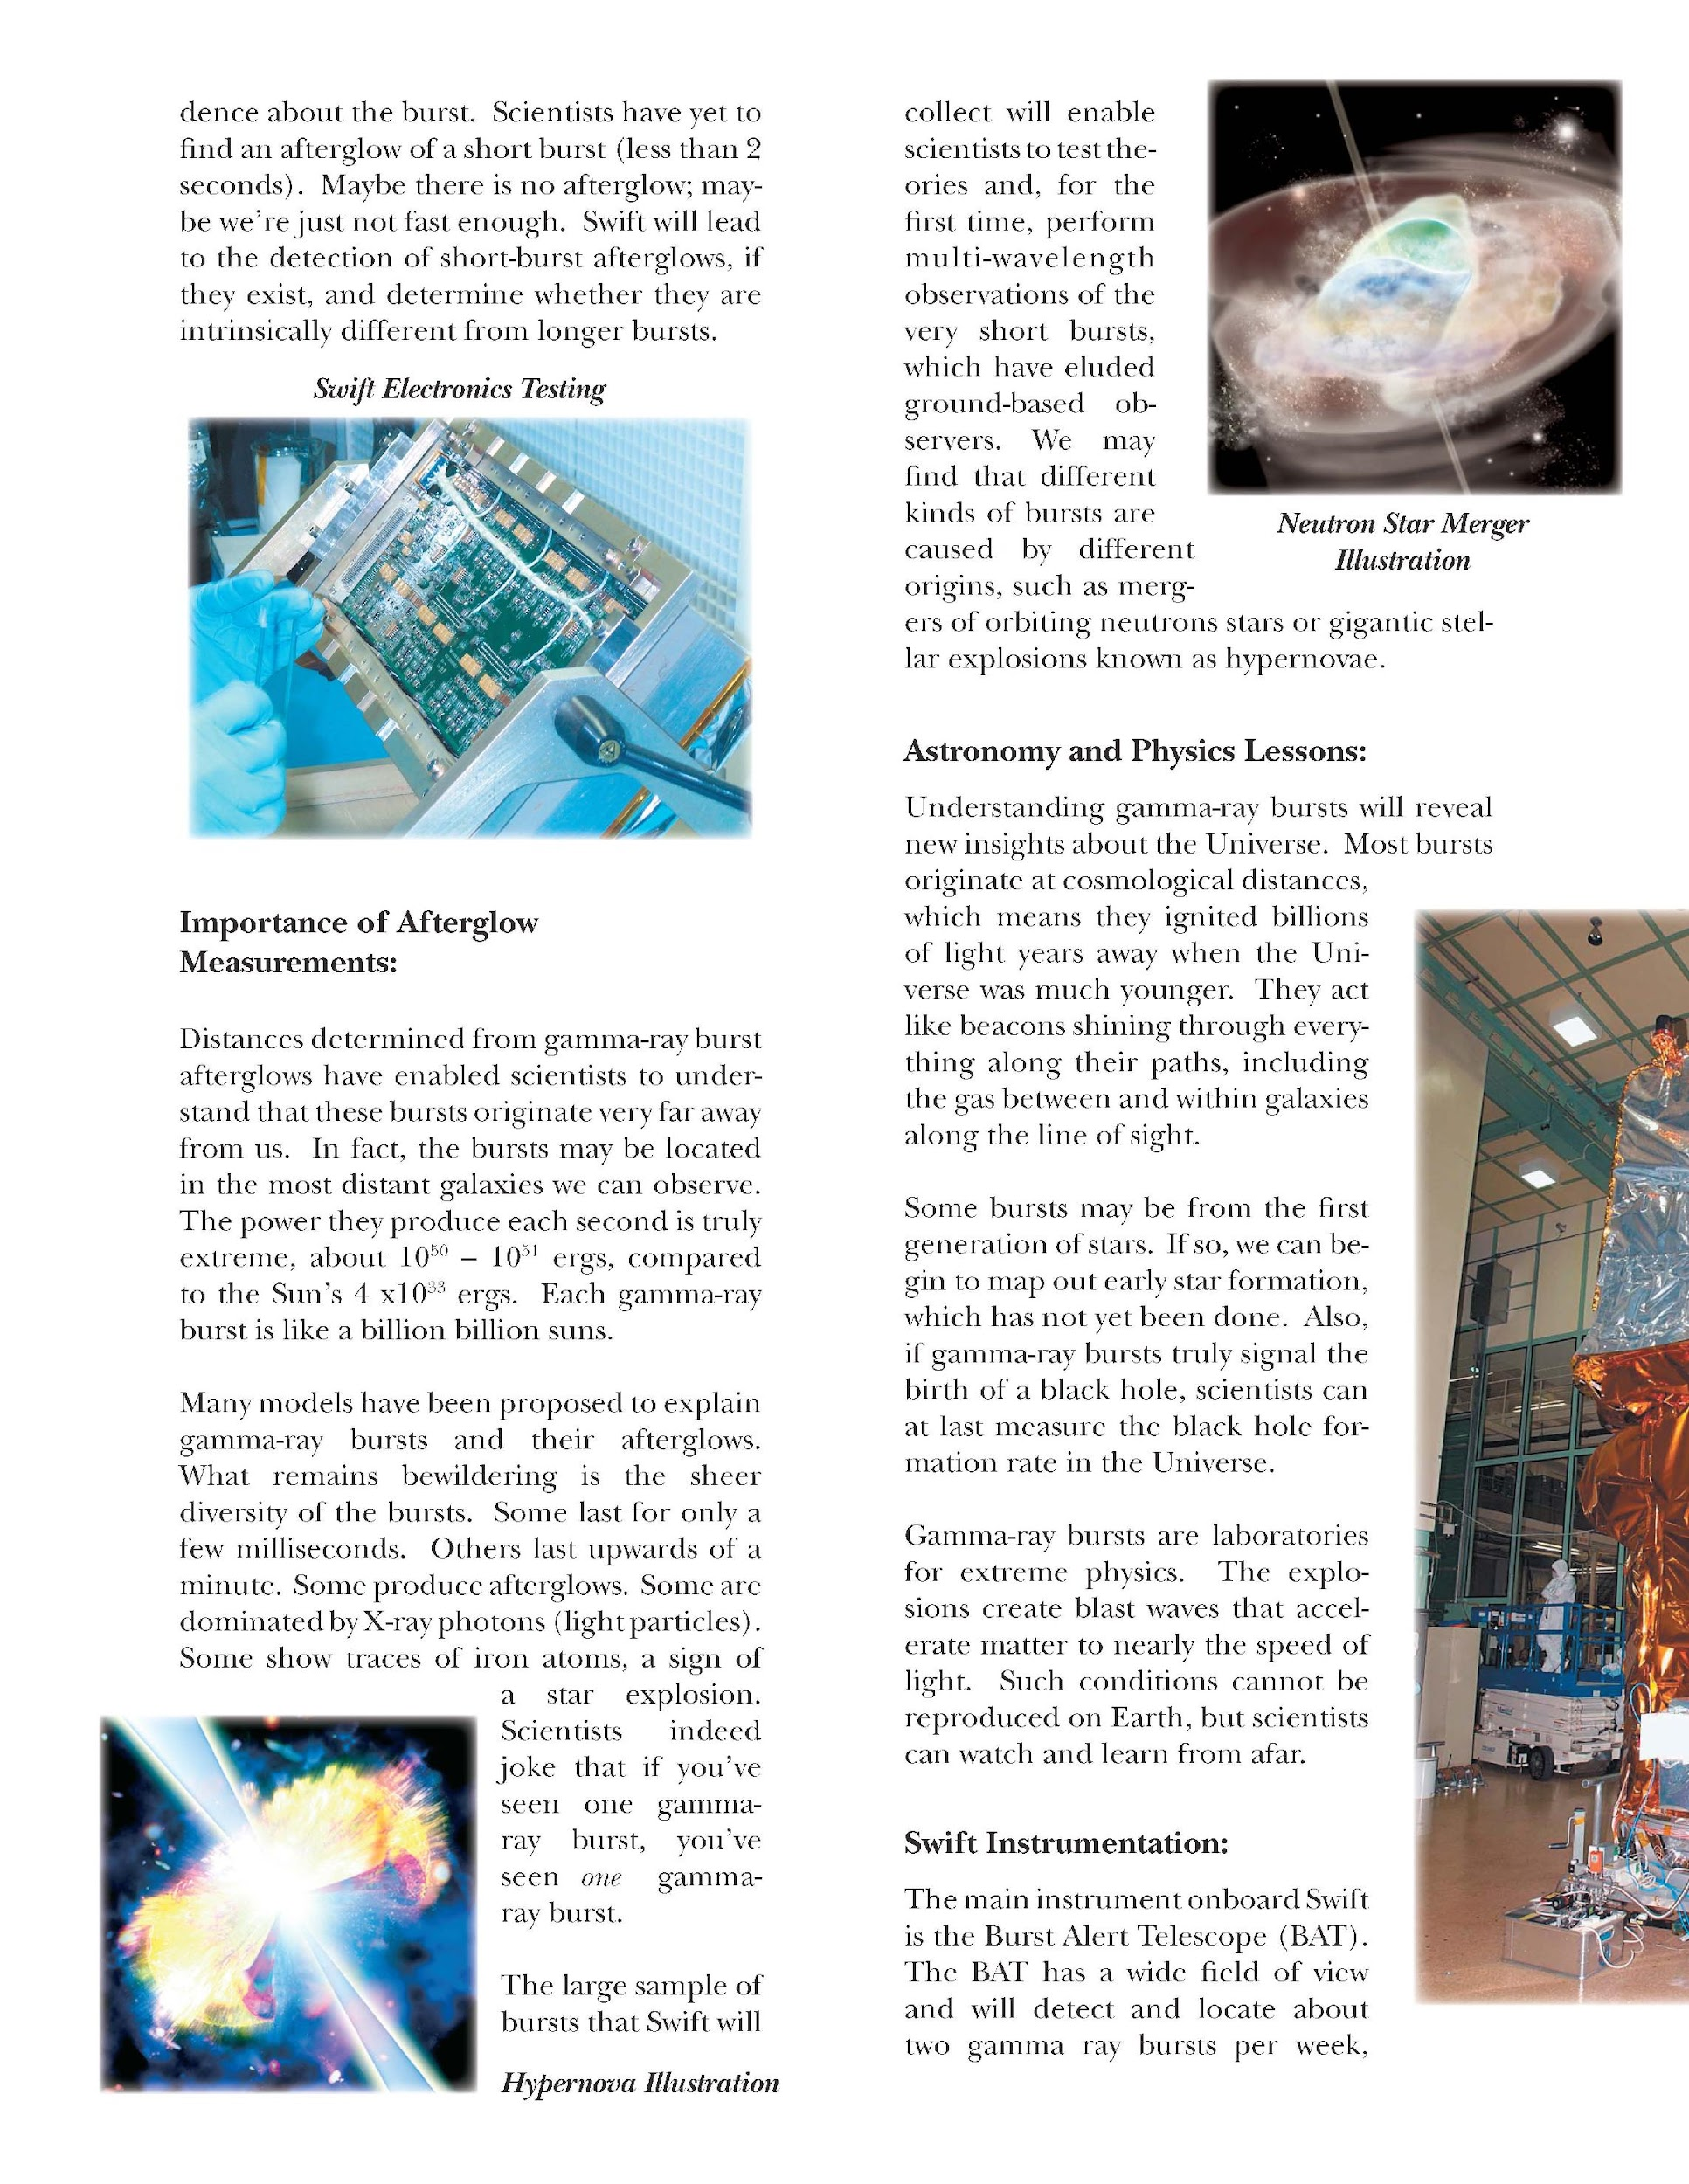
Launch Fact Sheet
4-page color brochure

Slide 8
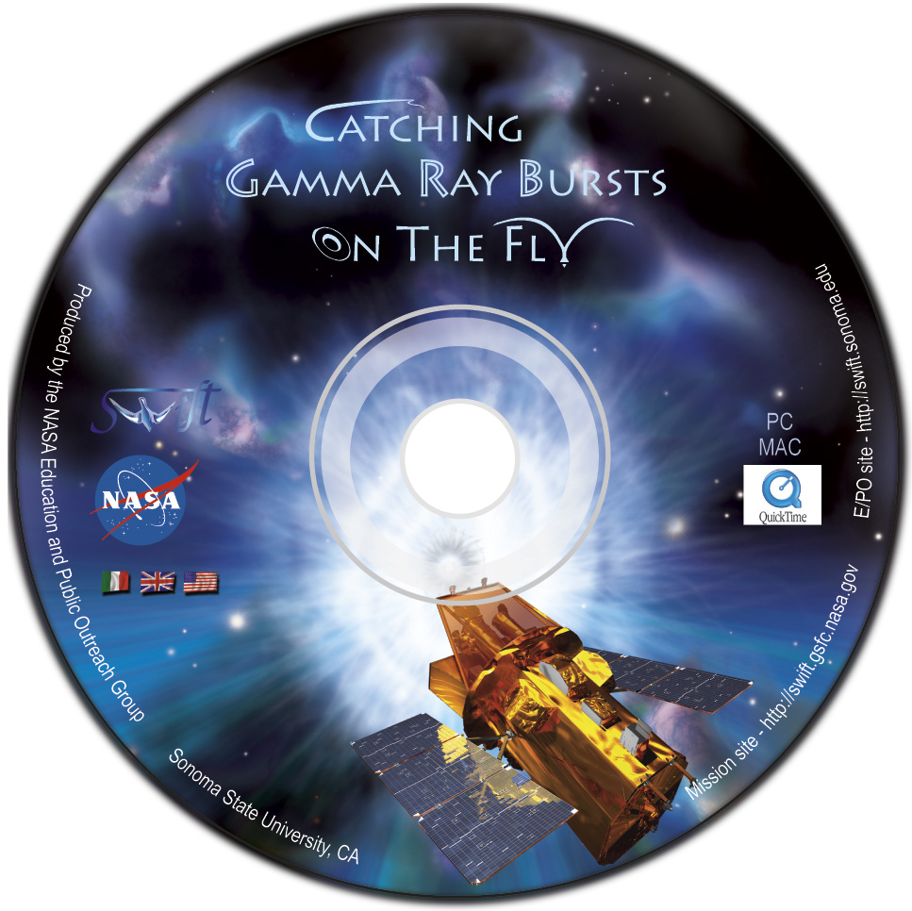
Swift Website CD
Capture of website http://swift.gsfc.nasa.gov right before launch
Includes http://swift.sonoma.edu
Includes downloadable versions of all classroom materials, as well as multi-media products and images

Slide 9
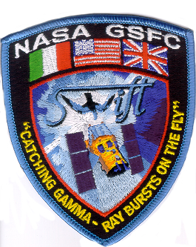

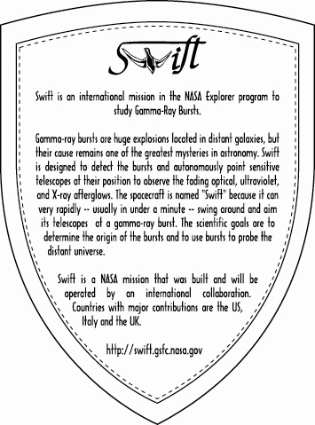
Stickers and patches
Stickers have mission description on back
Patches were contributed by Spectrum Astro

Slide 10
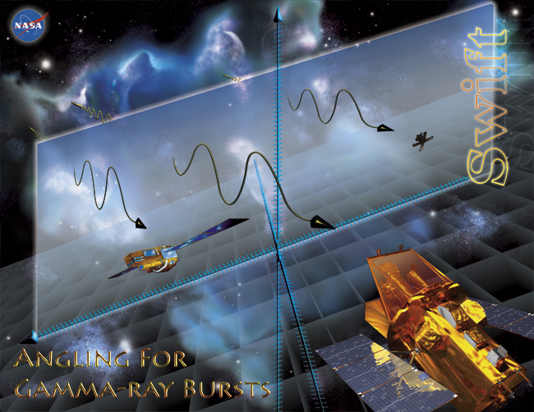
Angling for GRBs poster
Posters were printed at SSU
Reprint order is held up by communications product freeze – nothing is being done at GPO

Slide 11
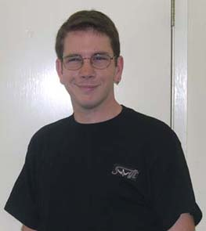
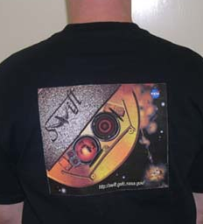
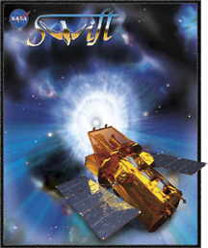
Swift T-Shirts
13 M, 9 L and 5 XL left
$13 each – I have order forms – see me to order

Slide 12
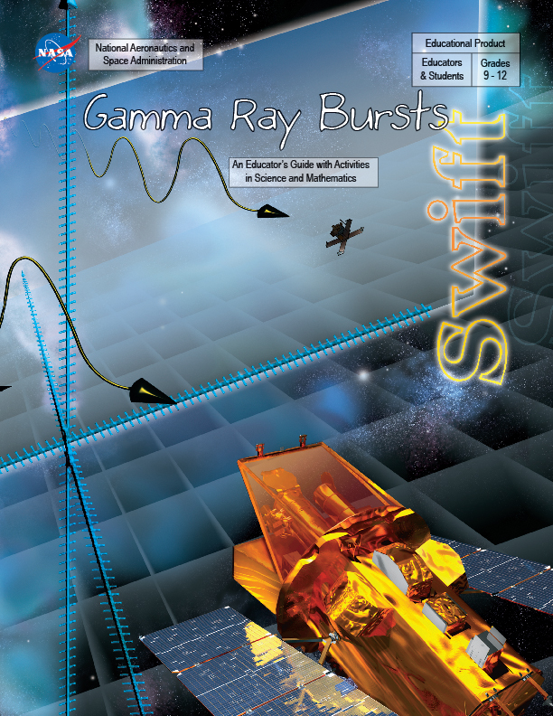
GRB Educator’s Guide
Now in print!
Aligned with national mathematics and science standards
Four classroom tested activities
Sorting out the Cosmic Zoo
Angling for GRBs
GRB Distribution on the Sky: The Plots Thicken
Beam Me Up!

Slide 13
Reaching OUT – FY04 totals
31 different presentations to students, teachers and the public by Educator Ambassadors and E/PO professionals
Over 3200 direct participants
WITN? has an estimated audience of 5,000,000 indirect participants

Slide 14
Reaching OUT – FY04
Swift/GLAST booth at:
California Science Teachers Association Meeting (10/03)
AAS Winter Meeting in Atlanta (1/04)
Expanding Your Horizons, SSU (3/04)
Penn State Space Day (4/04)
AAS Summer Meeting in Denver (6/04)
AAPT National Meeting in Sacramento (8/04)
SLAC Family Day (9/04)
HEAD Meeting in New Orleans (9/04)

Slide 15
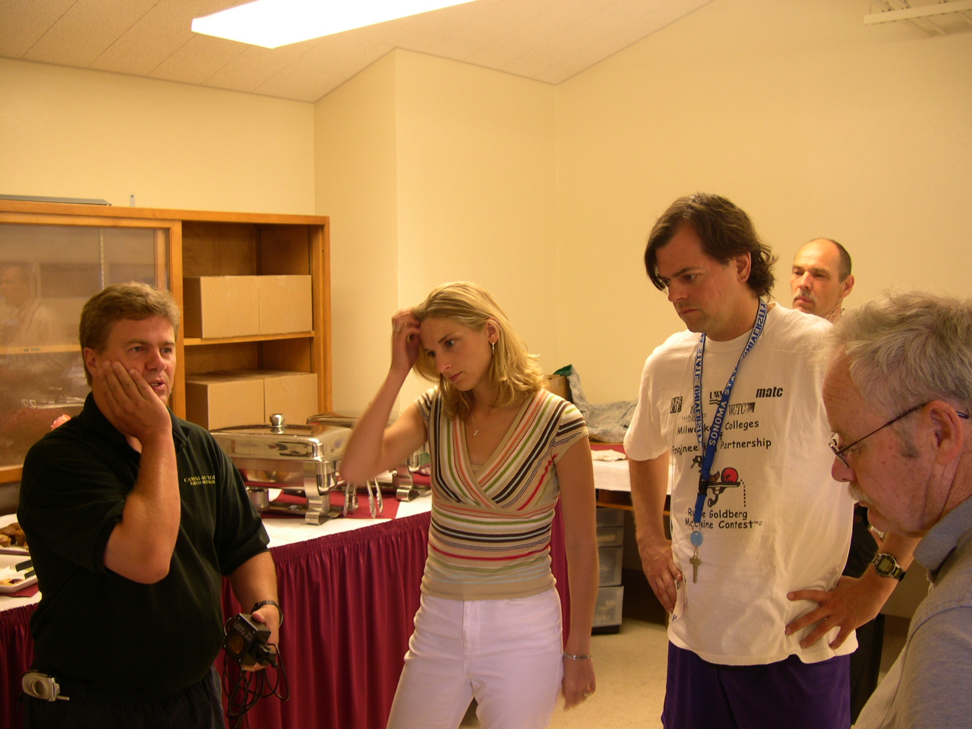
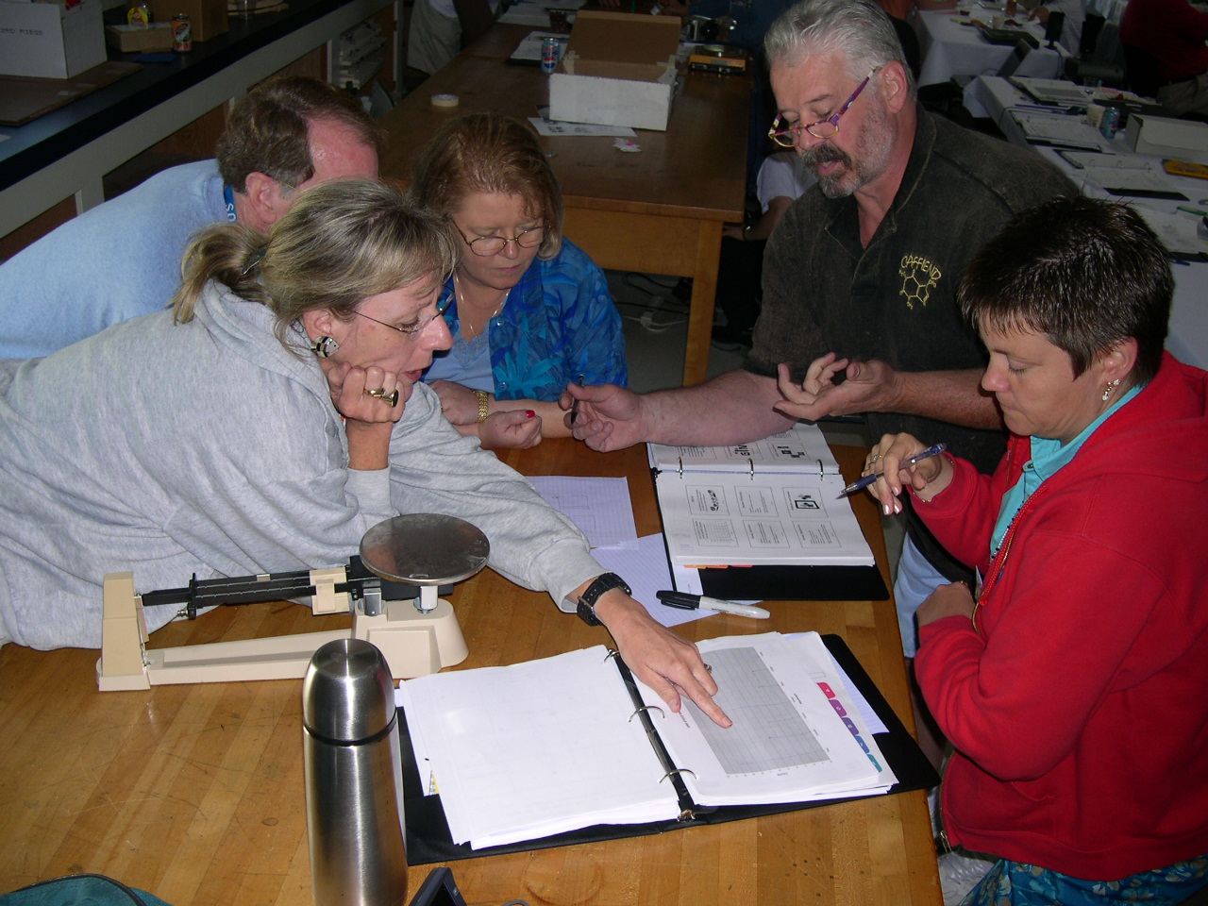
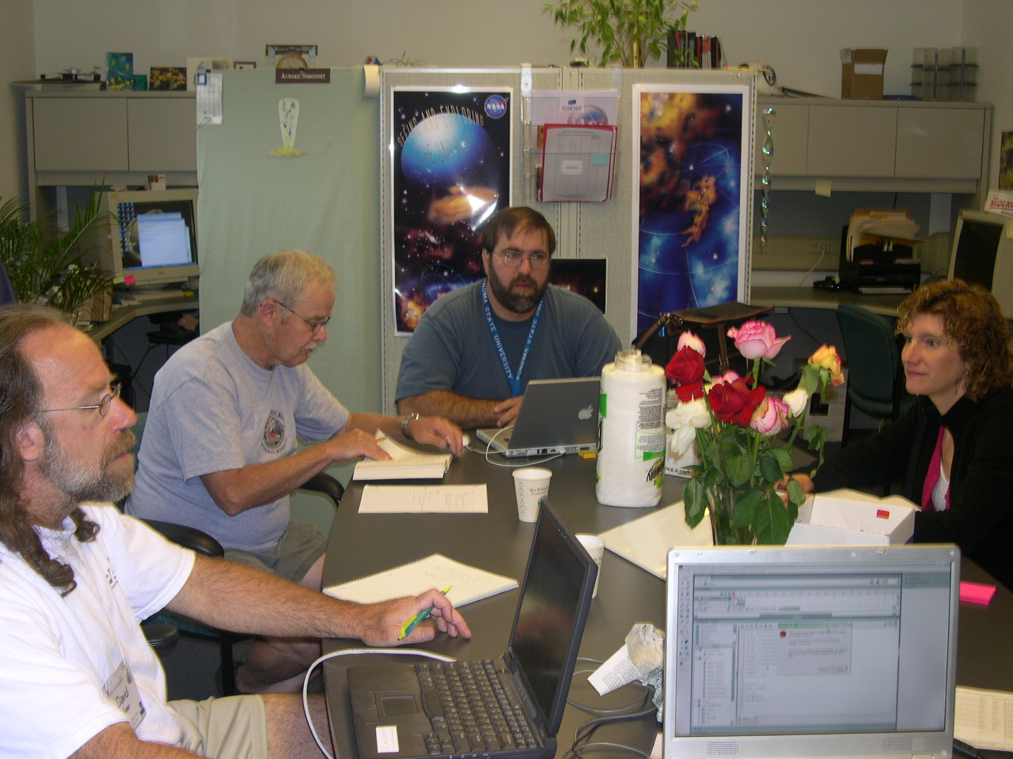
Educator Ambassador News
All 23 EAs from 7 different missions were trained at SSU for 10 days in July 2004.
Bruce Hemp, Rob Sparks and David Beier went to Florida to see the launch, and toured the rocket tower. Bruce was able to stay the entire week.

Slide 16
Educator Ambassador Presentations (since 10/03)
10/19-23/03: EA David Beier presented “NASA in Your Classroom with the Electromagnetic Spectrum” at the Missouri Department of Elementary and Secondary Education conference in Osage Beach, Missouri.
11/01/03: EA Rob Sparks presented “High Energy Astronomy In the Classroom” at the Wisconsin Association of Physics Teachers annual conference in LaCrosse, Wisconsin.
11/07/03: EA Rae McEntyre presented “NASA’s Swift Mission and the Electromagnetic Spectrum” at the Kentucky Science Teachers Association in Lexington, KY.
11/13/03: EA Rae McEntyre presented “Using the Electromagnetic Spectrum to Teach about Space” at the NSTA regional in Kansas City, MO.
12/03/03: EA David Beier presented “The Invisible Universe” at Rockhurst University in Kansas City, Mo.

Slide 17
12/15/03: EA Tom Arnold presented “Random walks through the Electromagnetic Spectrum” at State College High School in State College, PA.
01/9-10/04:EA David Beier presented “NASA, GEMS, and the Invisible Universe” at Kansas City Science City Union Station Museum in Kansas City, MO.
02/22-23/04: EA David Beier presented “GEMS Brings the Electromagnetic Spectrum to Life” at the INTERFACE Conference in Osage Beach, MO.
03/05/04: EA Rae McEntyre presented “Using the Electromagnetic Spectrum to Teach Physical Science Concepts” at the Kentucky Teaching and Learning Conference in Louisville, KY.
03/12/04: EA Rob Sparks presented “High Energy Astronomy In the Classroom” at the Wisconsin Society of Science Teachers annual conference in Appleton, Wisconsin.
03/17/04: EA Rob Sparks presented “Catching Gamma-Ray Bursts on the Fly” at Barlow Planetarium in Menashe, WI.
10/03 and 04/04: EA David Beier presented NASA our Welcomes You Invisible Universe at MOREnet Technology Integration Conference at Tan-Tar-A Resort, Osage Beach. MO

Slide 18
4/2/04 – EA Rob Sparks presented “Invisible Universe: The Electromagnetic Spectrum from Radio Waves to Gamma Rays” with E/PO staff member Sarah Silva at the National NSTA in Atlanta, GA.
04/28/04: EA Tom Arnold presented “Active Galaxies” at State College High School in State College, PA.
05/11/04: EA Rob Sparks presented “Catching Gamma-Ray Bursts on the Fly” at Wehr Nature Center in Franklin, WI.
06/7-8/04: EA David Beier presented “The effects of Gamma-Rays on Man-In-The-Moon Marigolds” for the Shawnee Mission School District in Shawnee Mission, Kansas.
06/23-24/04: EA Bruce Hemp presented “Catch the Wave” at the NTTI Blue Ridge West Conference, in Abingdon, Virginia
06/24-28/04 EA Rob Sparks presented two activities from “Invisible Light Sources and Detectors” Swift GEMS guide at the “Chandra and the X-ray Universe” workshop in Medford, MA.
06/27-07/02/04: EA David Beier presented “Taking your class on a Field Trip to Space” at the Greer Math, Science, and technology Conference in Exeter, New Hampshire.

Slide 19
07/16/04: EA Tom Arnold presented “Teaching High School Astronomy using SEU Materials” at the Penn State Science Workshops for Educators (Swift Sponsored Workshop).
07/17/04: EA Tom Arnold presented “Catastrophic Astronomy in the Pre College Classroom” at the Penn State Science Workshops for Educators (Swift Sponsored Workshop).
09/07/04: EA Tom Arnold presented “Using Space Science to Enhance Science Reading and Writing Skills” at State College High School in State College, PA..
09/18/04: EA Rob Sparks presented “Catching Gamma-Ray Bursts on the Fly” at Astrofest in Kankakee, IL.
10/09/04: EA Erich Landstrom presented “Upcoming missions on the Structure and Evolution of Universe” at FAST 2004 at Boynton Beach Community High School.
10/30/04: EA Rae McEntyre presented “Using NASA Science to Enhance Your Curriculum” at Kentucky Council of Teachers of Mathematics in Frankfort, KY
11/13/04: EA Bruce Hemp presented “Catch a Wave” at NTTI Regional Master Teacher training at James Madison University, VA

Slide 20
10/15/04: EA Erich Landstrom presented “FAST and Swift” at FAST 2004 at Doubletree Hotel, FL
11/01-23/04: EA Thomas Estill presented four workshops titled “Swift Science” at Chabot Space and Science Center Planetarium in Oakland, CA.
11/05/04: Rae McEntyre presented “The Biggest Bang Since the Big One” at NSTA Midwest Regional Conference at Indiana Convention Center and RCA Dome, IN.
11/30/04: EA Rae McEntyre presented “Using NASA Since to Enhance Your Curriculum at Mathematics at Kentucky Council of Teachers of Mathematics, KY.
11/19/04: EA Rae McEntyre presented “The Cosmic Zoo at Racing Toward Proficiency: No Teacher Left Behind at Hyatt Regency/Lexington Conference Center, KY
11/19/04: EA Rae McEntyre presented” Where in the Sky is it?” at Racing Toward Proficiency: No Teacher Left Behind at Hyatt Regency/Lexington Conference Center, KY
12/03/04: EA Rae McEntyre presented “The Biggest Bang Since the Big Bang” at Journey Into Science at Greater Richmond Convention Center, VA.

Slide 21
01/08/05: EA David Beier presented “Exploring the Invisible Universe” at American Association of Physics Teachers at Albuquerque Convention Center and University of New Mexico, NM.
02/16/05: EA Thomas Estill presented “Review of SEU Teacher Resources” at Chabot Space and Science Center Planetarium in Oakland, CA.
12/10/04: EA Thomas Arnold presented “Swift Mission” at Science Education Workshop at State College Area High School, PA
Non-EA presentation
12/03/04: Christopher Palma presented “Seeing the Universe in a Whole New Light with the NASA Swift” at Science Teaching: Rekindle the Magic at Hershey Lodge and Convention Center, PA.

Slide 22
SSU E/PO Presentations (since 10/03)
10/03 CSTA, Long Beach, CA:
GEMS: Invisible Universe: The Electromagnetic Spectrum from Radio Waves to Gamma Rays by Lynn Cominsky and Sarah Silva
Nature’s Second Biggest Bangs: The Gamma Ray Burst Zoo by Phil Plait, Lynn Cominsky, and Sarah Silva
Seven Ways a Black Hole Can Kill You by Phil Plait.
11/03 NCN/AAPT, Berkeley, CA: Gamma Ray Bursts in the Classroom: An overview of the Gamma-ray burst educator unit by Sarah Silva
11/03 AGU, San Francisco, CA: NASA High Energy Space Science E/PO at SSU: Program Overview and Lessons Learned by L. Cominsky and P. Plait.
1/04 Mission and Technology Lecture Series, Spectrum Astro, Gilbert, AZ: Einstein’s Universe and Beyond by Lynn Cominsky

Slide 23
3/04: Space Science Institute for Professional Development Training, Boulder CO: The SEU Educator Ambassador Program by Sarah Silva et al.
3/04: Eastbay Astronomical Society, Oakland, CA: Seven Ways a Black Hole Can Kill You by Phil Plait
4/04: NSTA Atlanta, GA:
GEMS: Invisible Universe: The Electromagnetic Spectrum from Radio Waves to Gamma Rays by Sarah Silva and Rob Sparks
Nature’s Second Biggest Bangs: The Gamma Ray Burst Zoo by Sarah Silva and Rae McEntyre
Modeling the Universe Short Course. by: M. Dussault et al. including S. Silva
5/04: Society of Astronomical Sciences Big Bear, CA: The Global Telescope Network by P. Plait
6/04 Chicago 2004 Chicago, IL: The SEU Educator Ambassador Program by Sarah Silva et al.
8/04 AAPT Sacramento, CA: Gamma Ray Bursts in the Classroom: An overview of the Gamma-ray burst educator unit by Phil Plait

Slide 24
9/04 HEAD Meeting New Orleans, LA
Swift and the GTN at the Swift team meeting by Lynn Cominsky
Modeling the Universe Short Course by M. Dussault et al. including Sarah Silva.
NASA’s Swift Education and Public Outreach Program by Cominsky et al.
The SEU Educator Ambassador Program by S. Silva, et al.
Modeling the Universe: Professional Development for Teachers Designed by NASA's Structure and Evolution of the Universe E/PO Program by M. Dussault et al. including Sarah Silva and Phil Plait.
10/04 CSTA San Jose, CA
GEMS Invisible Light Sources and Detectors by S. Silva and P. Plait
Angling for Gamma-ray Bursts by Phil Plait and Sarah Silva
01/05 AAS San Diego, CA Modeling the Universe by S. Silva, P. Plait, et al
1/05 San Francisco, CA: Exploding Stars, Blazing Galaxies and Monstrous Black Holes: The Extreme Universe of Gamma-ray Astronomy, Benjamin Dean Lecture for California Academy of Sciences by L. Cominsky
2/05 San Francisco, CA: A Swift View of the Universe physics colloquium at University of San Francisco by L. Cominsky

Slide 25
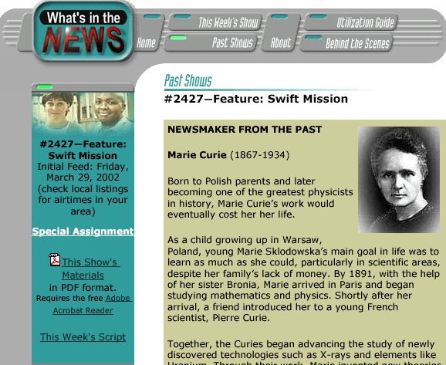
For FY04, 2 pieces produced:
November 14, 2003: Weather or Not: the Space Environment
April 13, 2004: New Eye on the Universe
In April, 2004 WPSX cancelled WITN? – no new shows will be produced.
Tracy Vosburgh is finalizing a series of 6 five-minute educational modules, using some of the Swift footage

Slide 26
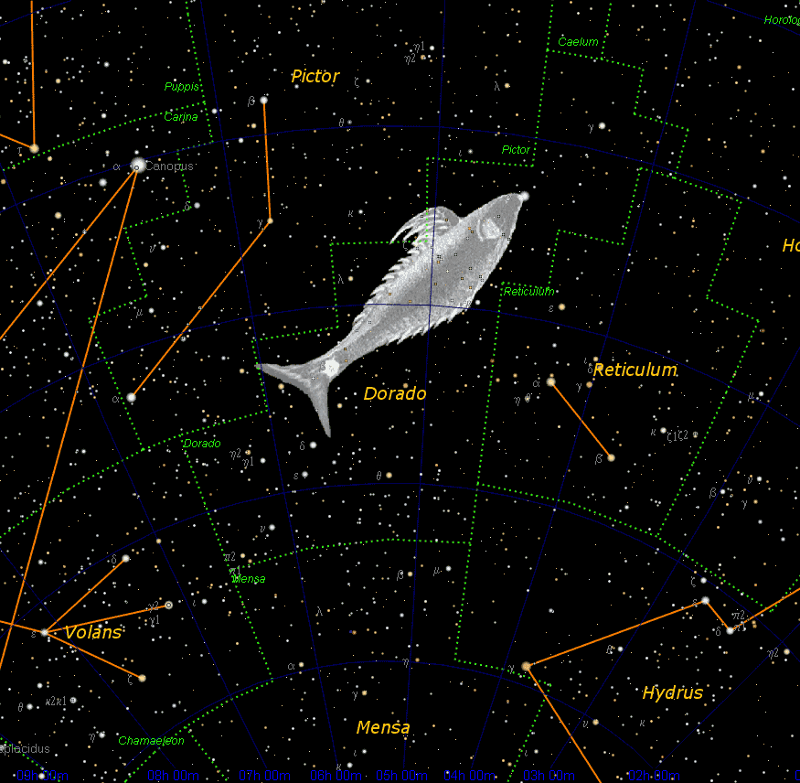
GRB SkyMap: http://grb.sonoma.edu
Updated semi-automatically using GCN alerts
Features lightcurves, mission information, finding charts, constellation maps and short writeups

Slide 27
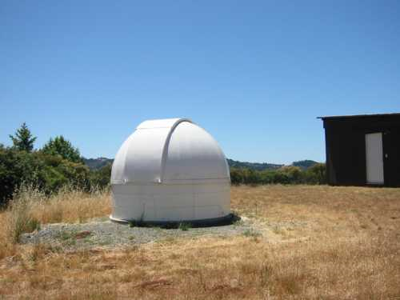
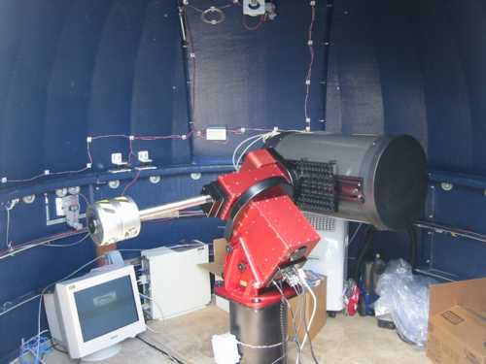
Global Telescope Network
http://gtn.sonoma.edu
Internet being installed in March

Slide 28
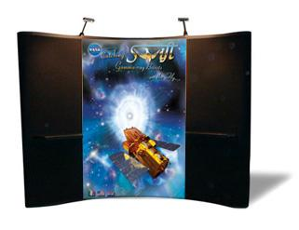
New Exhibit Booths
New Swift only booth for scientific conferences

Slide 29
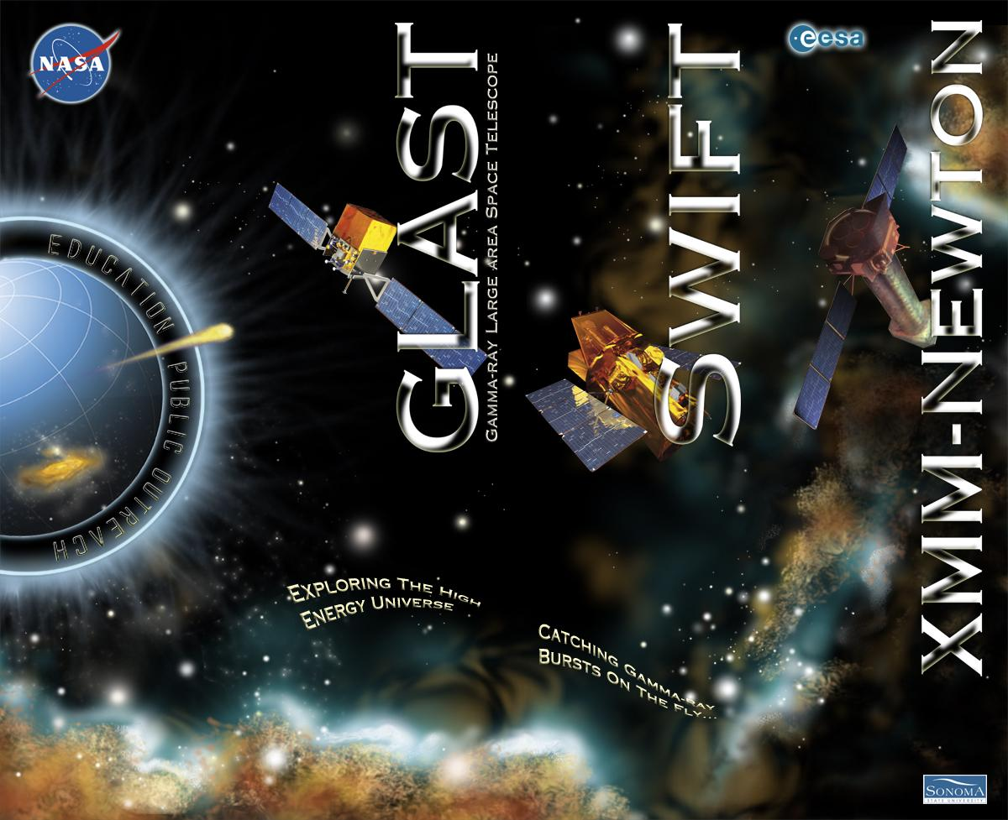
New Exhibit Booths
New E/PO booth features multi-missions for use at educator conferences

Slide 30
Program Evaluation
WestEd evaluations during FY2004
Two CSTA workshops at the NSTA in October 2003 – GEMS and GRB Activity 1 (Sorting the Cosmic Zoo)
The Swift Gamma-ray burst educator’s guide
Summer 2004 Educator Ambassador Training
Newton’s Laws Poster Set
Ongoing evaluation of workshops given by EAs
OSS Product Review
GRB Poster (with activity two from the GRB educator guide on the back)
Swift model booklet
SSERD: Poster and model booklet are now submitted

Slide 31
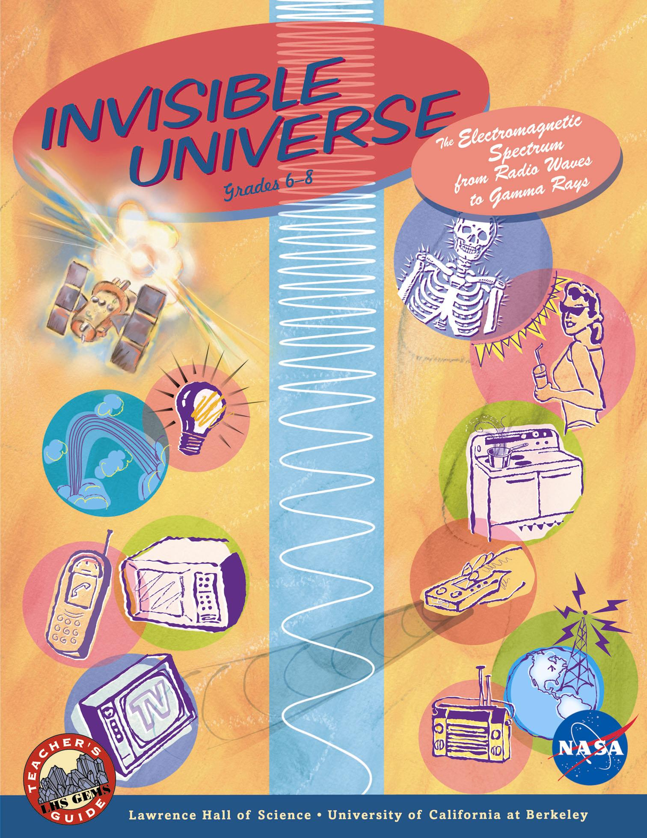
Program Evaluation
Swift GEMS guide extensively reviewed by NASA Education Office panel of experts
They are recommending that our GEMS guide “be distributed through NASA Teacher Training and Workshops for High School Teachers, with suggested revisions to be incorporated on the next print run."

Slide 32
Near-Future Plans
3rd Annual High Energy Workshop for Amateur Astronomers with the AAVSO March 20-23, 2005
Co-sponsored by GLAST and Swift
WestEd will evaluate
GRB-related talks by Cominsky, Plait, Price/Henden, Fishman, Rhoades
SGR talk by Kouveliotou
http://www.aavso.org/aavso/meetings/hea3.shtml
CSTA 05 "NASA Universe Strand" - Swift workshops include:
two from the GEMS guide
one from the GRB guide
one that covers the missions

Slide 33
Near-Future Plans
Swift launch will be featured in Planetarium Show being produced by Denver Museum of Nature and Science – to air in late 2005
The Tom Lucas-produced NOVA show with Swift launch will air in 2006
GTN Observations will include GRBs, should be on the Internet within 2 months
Quarterly Swift electronic newsletter - coming soon!
6 week curriculum for HS students using GEMS and GLAST-sponsored TOPS Scale the Universe – to be piloted at Roseland University Prep during spring 2005
To see the latest talks and workshops scheduled for all SSU-supported missions http://epo.sonoma.edu/newsandevents.html

Slide 34
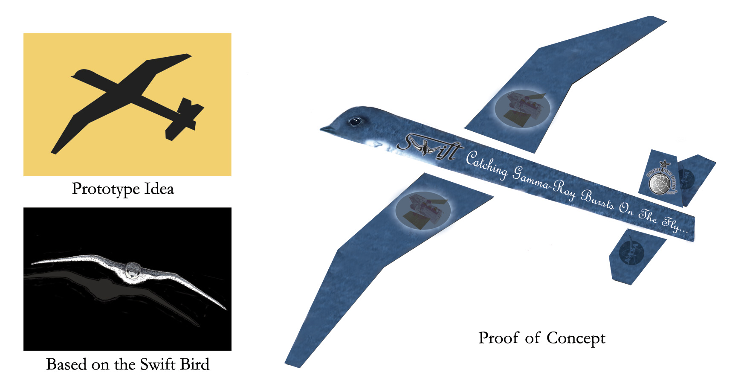
New Giveaway Concept

Slide 35
PR Report
Launch PR included 2 briefings
Science briefing featuring Hertz, Gehrels, Wells, Chincarini
Mission briefing featuring Kinney, Dovale, Walsh, Edison, Dezio, Tumbiolo
Launch PR preparations also included:
PAO plan
Launch Press Kit
Swift portal web site: http://www.nasa.gov/swift
Coverage of launch included photograph in most papers

Slide 36
PR Report
2005 releases
1/5/05 Swift Turns On and Sees a Blast of Bursts (HQ release - BAT 1st light and x-ray afterglow)
1/5/05 Swift X-ray Telescope Sees Its First Light and Captures Its First Gamma-Ray-Burst Afterglow (Penn State release with Cas A image)
1/21/05 Swift Mission Images The Birth Of A Black Hole (HQ release – 1st prompt X-ray detection)
2/1/05 Swift Sees Pinwheel Galaxy, Satellite Fully Operational (Penn State release – UVOT 1st light with M101 UV and optical images)

Slide 37
PR Report
First NASA Science Update - 2/18/05
NASA Observes One Of Brightest Cosmic Explosions (SGR 1806-20 flare)
Featured David Palmer, Bryan Gaensler, Roger Blandford and Andy Fruchter (moderated by Michael Salamon)
6 coordinated releases – CfA, Australia, Israel, UC Berkeley, VLA, UK – sent out through AAS
http://www.nasa.gov/vision/universe/watchtheskies/swift_nsu_0205.html
Very good print coverage despite Friday PM airdate

Slide 38
PR Report
Swift Press plans now approved by HQ!!
Press plan for scientists – describes procedures all Swift team members are to use for press release preparation, public media appearances, popular articles, press conferences
Rapid Response Telecon Press Briefing plan – describes procedures to be used to identify, schedule and support this “new” type of press briefing which is done over the web and phone lines
Embargo policy – describes policies for coordinated releases, especially those with international partners
Will be distributed to team immediately following this meeting

